Slide 1
Cognitive Impairments
Assistive Technologies for
Presented by:
Anika Amour
Chester Sean Daniel
Ixchel Jeffers-Tobas
Josanne Diaz
Rochabelle Haynes-St. Louise
Selvin Harrinarine

Slide 2
What is Assistive Technology?
Assistive Technology is any item, equipment, product or system that is used to increase, maintain or improve an individual with disabilities functional abilities.

Slide 3
What is meant by ‘Cognitive Impairments’?
According to the American Association on Intellectual and Developmental Disabilities (AAIDD), cognitive impairment is an intellectual disability characterized by significant limitations both in intellectual functioning and in adaptive behavior as expressed in conceptual, social and practical adaptive skills. This disability originates before age 18.

Slide 4
Cognitive impairments can be associated with many disabilities and disorders that can be present at birth or acquired later in life, such as dementia and stroke. The image shows a broad range of cognitive disabilities.
For example, dyslexia is one of the more common disabilities that is said to affect up to 10% of the population
- Ruth Ellison, 2011

Slide 5
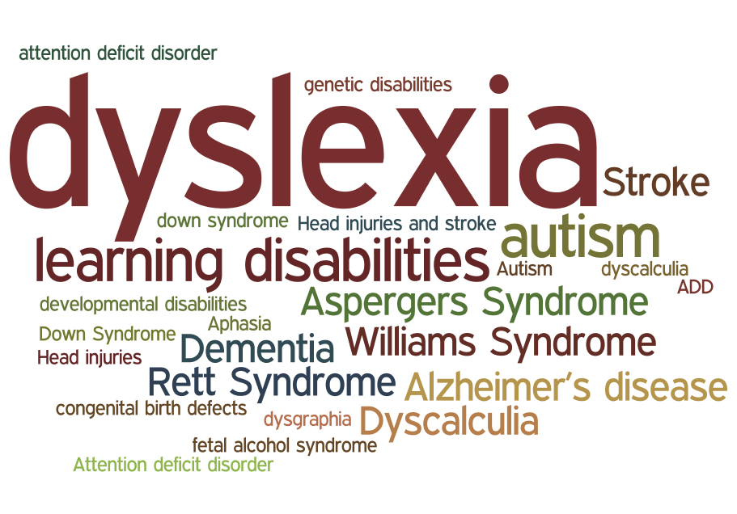

Slide 6
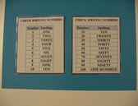
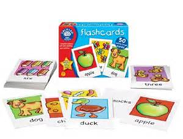
Low Tech Devices
Charts and cuing devices
Flash Cards

Slide 7
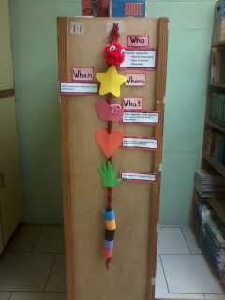
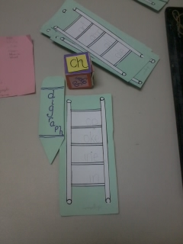
Low Tech Devices
Brady
Digraph Ladder

Slide 8
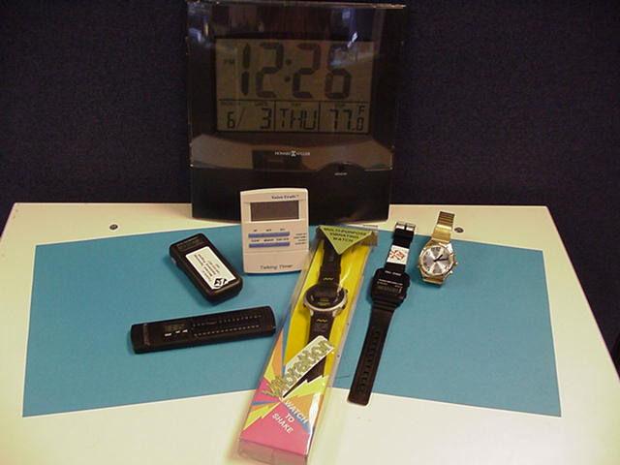
Mid Tech Devices
Story books with CD/audio books
Watches, timers and clocks

Slide 9
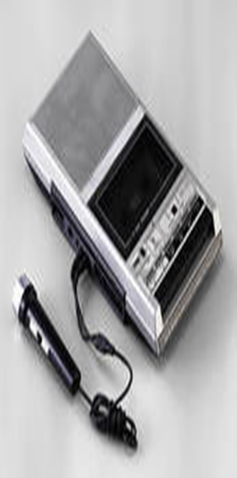
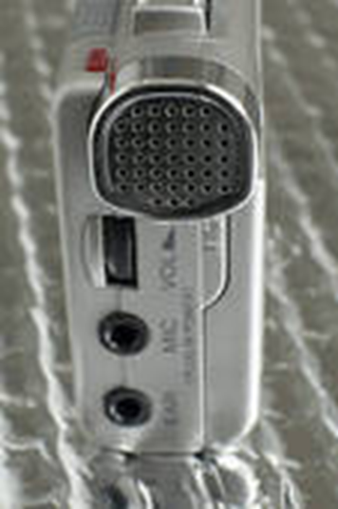
Mid Tech Devices
Tape Recorders

Slide 10
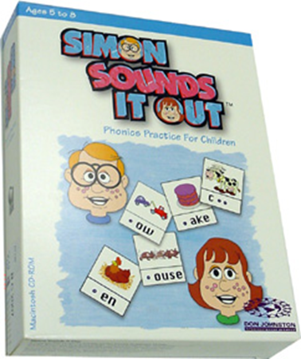
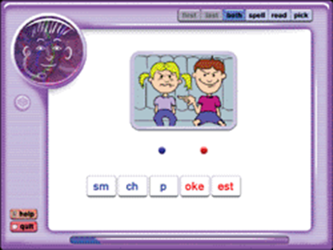
High Tech Devices
Simon S.I.O

Slide 11
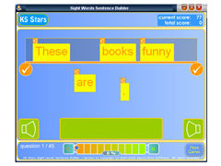
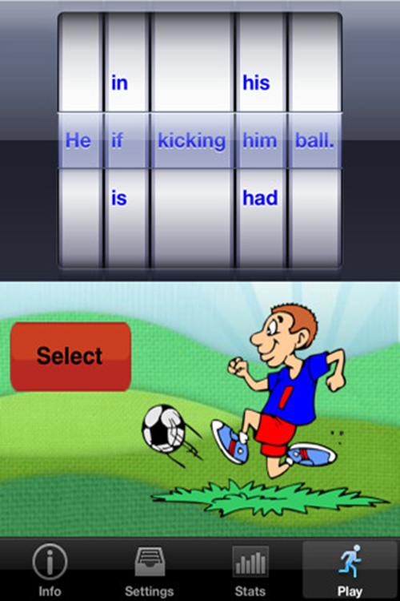
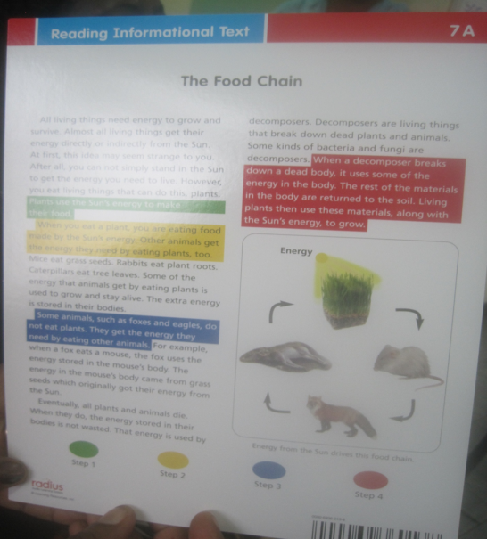
High Tech Devices
Sight Words Sentence
Builder
Sentence
Builder
Radius Program

Slide 12
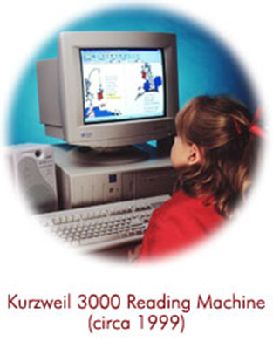
High Tech Devices

Slide 13
Snippets of Assistive Technology in action

