Slide 1
Assistive Technology for Reading
Presenters:
Antonia Mohammed
Arlene Chris Anne Julien
Lisa Philip

Slide 2
What is Assistive Technology
Any item used to increase, maintain, or improve functional capabilities of a child with a disability.
Any service that directly assists a child with a disability in the selection, acquisition, or use of an assistive technology device

Slide 3
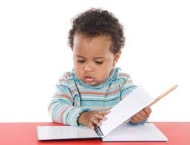
Reading
The process of extracting meaning from a written or printed text.

Slide 4
AT Devices for students with Hearing Impairments/Auditory
Assistive listening devices
used by people who are hard of hearing, use hearing aids and by some Deaf people who use cochlear implants.
Sometimes called FM units, used to reduce background noises and focus on the speaker's voice.
Notes:
A speaker wears a microphone where the sound transmits through the FM waves to a receiver that is connected to the hearing aid or cochlear implant worn by the person who is deaf or hard of hearing is wearing.

Slide 5
AT Devices for students with Hearing Impairments/Auditory
Closed captioning
the text that goes on the bottom of the television screen to inform deaf people of what is being said.
Notes:
This technique began in 1979 with a handful of television programs captioned. Now most of the television programming is captioned. To see if the videotapes or programs are closed captioned, look for a small box with letters 'CC' inside or a small box with a cartoon balloon dialogue marker.

Slide 6
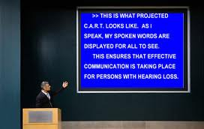
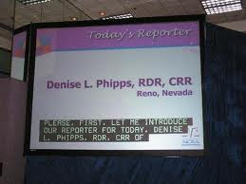
AT Devices for students with Hearing Impairments/Auditory
Live Remote Captioning (LRC)
(sometimes referred to as CART - Communication Access Realtime Transcription) delivers instant speech to text transcription.
Notes:
This can be accomplished on site or remotely using communications technology. LRC can be used in lectures, at conferences or other live events.

Slide 7
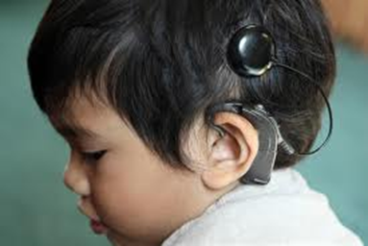
AT Devices for students with Hearing Impairments/Auditory
A cochlear implant:
A device that is implanted in the cochlea to bypass the natural ear mechanism and connect to the auditory nerve
Notes:
. It is usually placed in people with severe to profound hearing loss who show little to no benefit from hearing aids. This device is controversial in the deaf community, especially when it is implanted in young children.

Slide 8
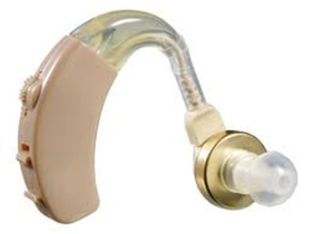
AT Devices for students with Hearing Impairments/Auditory
Hearing aids:
Mechanical devices that amplify all sounds to the person with a hearing loss.
Notes:
come in many different sizes and shapes and vary in position from behind the ear to in the ear. Depending upon the type of hearing loss the person may have, the sounds may be distorted and be too loud.

Slide 9
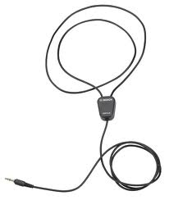
AT Devices for students with Hearing Impairments/Auditory
A Hearing Loop:
A coil of wire around a room or part of a room that amplifies sound and reduces background noise.
Notes:
Users of hearing aids within the loop set their aids to a certain setting to receive the transmission. Hearing loops can be permanently installed or portable.

Slide 10
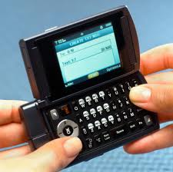
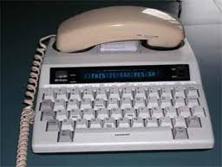
AT Devices for students with Hearing Impairments/Auditory
Text Telephones (TTYs):
Looks like a small typewriter with a small LCD screen and a cradle for the telephone receiver in order to receive the sounds as one types on the TTY.
Notes:
People who are deaf or have a hearing impairment use to communicate with others on the telephone. In order for a person who is deaf to call on the TTY, the person on the other end must also have a TTY.

Slide 11
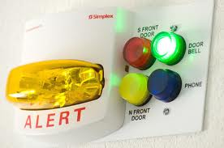
AT Devices for students with Hearing Impairments/Auditory
Visual Alert Signalers:
Devices that use flashing lights to alert the deaf person to the ringing of a phone or fire alarm.

Slide 12
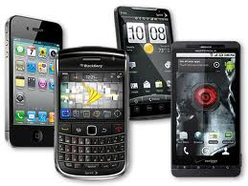
AT Devices for students with Hearing Impairments/Auditory
Mobile phones, Smart phones and Pagers
Allow the deaf person to send e-mails, faxes, pages and call people who have TTY and through relay.

Slide 13
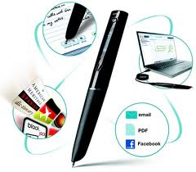
AT Devices for students with Dyslexia
Livescribe smartpen
Facilitates the note taking and learning process.
Notes:
Recording classroom discussions and taking fewer notes allows the dyslexic student to spend more time listening and learning. When returning to the material for homework or review, students have an opportunity to listen to important information a second time, add notes that may be of significance and review what has already been written.

Slide 14
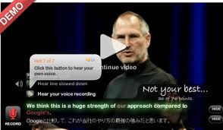
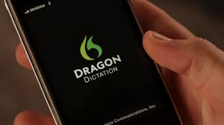
AT Devices for students with Dyslexia
Dragon NaturallySpeaking:
Technological aide that facilitates the learning process for the dyslexic student.
Notes:
Dragon Naturally Speaking for PC users and Dragon Dictate for Mac users is a voice recognition program that allows you to dictate your ideas and watch your words appear on the computer screen. It works for those who have word retrieval difficulties, grapho-motor weaknesses or problems committing ideas to paper in a timely fashion.

Slide 15
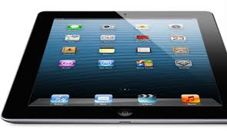
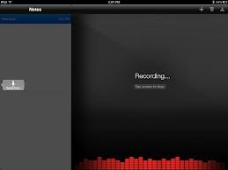
AT Devices for students with Dyslexia
iPads/Tablets Apps
Dragon Dictation app (free) is a terrific solution for recording responses to short-answer questions. This app is a speech-to-text app..
For fluency work, having students record themselves reading on iPads using Audio Note (there’s a "lite" version for free).
Notes:
If a student is not able to write a short-answer response independently, he or she may open a new note in Dragon and speak his/her answer into the iPad microphone. This allows the teacher to focus on the student’s comprehension of the material without forfeiting the rigor of work the student is capable of doing due to the student’s writing ability

Slide 16
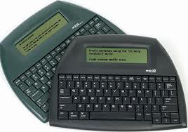
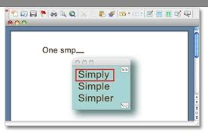
AT Devices for students with Dyslexia
Word Processors:
NEO2 word processor from Renaissance Learning with Co:Writer by Don Johnston. Co:Writer eliminates the pain of spelling.
Notes:
Luckily, for students with dyslexia, dysgraphia or other learning disabilities, it predicts words. Students enter the beginning sound of the word they want, and it presents a list of 6 words to choose from.

Slide 17
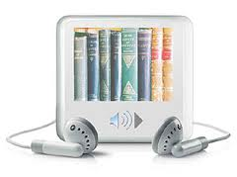
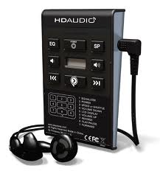
List of AT Devices for students with Reading Problems
Audio books and publications
Recorded books allow users to listen to text and are available in a variety of formats, such as audiocassettes, CDs, and MP3 downloads. Eg: Products and services to consider
Audible.com
Bookshare
Kurzweil 3000™ Literacy and Reading Programs
Recorded Books on PlayAway
Learning Ally

Slide 18
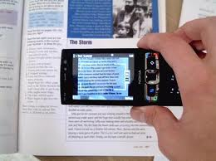
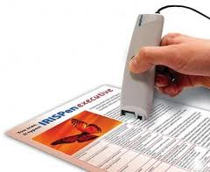
List of AT Devices for students with Reading Problems
Optical character recognition:
Allows a user to scan printed material into a computer or handheld unit. The scanned text is then read aloud via a speech synthesis/screen reading system.
Products to consider
WYNN™ Literacy Software Solution
Kurzweil 3000™
Kurzweil 3000™ USB Port/Flash Drive
Intel Reader
KNFB
The Quicktionary Reading Pen
Notes:
Optical Character Recognition (OCR) is available as stand-alone units, computer software, and as portable, pocket-sized devices.

Slide 19
RefErences
http://www.adcet.edu.au/View.aspx?id=4047
http://dyslexia.yale.edu/Technology.html

